Slide 1
Life Insurance and retirement valuation

Slide 2
Tutorial 2
Cash flows and products

Slide 3
Tutorial 2 suggestion in Tutorial 1
Read Modules 1, 2 and 3 and answer any questions in the textbook
Rewrite Module summaries in your own words
Watch the videos in Module 1, 2 and 3
Practice your writing skills by summarising the videos in Modules 2 and 3
Write a short note on the reflection exercise on page 13 of Module 2
Send any questions/requests for topics via discussion thread “Tutorial 2” that will be set up tomorrow. Closing date will be end of Monday
Search for real examples for some of the products in Module 3

Slide 4
Example: Module 3 Question 3
You have been asked to peer review claim termination rates for disability income. What process would you follow?
Answer:
This is a slightly odd question at this point in your studies as we derive rates in the Product Development subject and we have not discussed what is meant by peer review. Don’t worry if you struggled with this question

Slide 5
Module 3 Question 3
The question in the textbook originally asked about peer review claim termination rates for TPD. As that class of business does not have termination rates then the answer would have been that there is no need for peer review. The intention of the original question was to test if you understood the contract design rather than peer review.

Slide 6
Process for answering Fellowship questions
Address the question
State the obvious
Ideas
Structure
Time management
Read question

Slide 7
Module 3 Question 3
How did you approach an answer to the question?
Were you able to generate ideas?
Was there anything obvious to state?
I would argue that the answer is possible from first principles:

Slide 8
Module 3 Question 3
I would argue that the answer is possible from first principles:
does it need a review – no, then end of process
if yes (i.e. a different product), then it is high-level and not detailed.
was it a big and important job – materiality?
how was it completed?
how do the results compare with expected (e.g. last time’s results)?

Slide 9
Tutorial 2 Exercise
Form an opinion and justify it

Slide 10
Own your Answer
The great British actuary Frank Reddington said:
“As a profession we are apt to be accurate, cautious, consistent and reticent, and in these lies our strength; but if they do not leave enough room for impulse and imagination, they can be a weakness. The actuary who is only an actuary is not an actuary.”
Write a brief paragraph or two discussing whether or not you agree before looking at the solution on the next two pages.

Slide 11
What did you say?
Need to state whether you agree or otherwise
Yes- actuary needs to see various dimensions of a problems and external forces
Can’t focus solely on mathematical or financial interests
Can’t be expert in all areas
Implies awareness of other areas and willingness to seek advice, where appropriate
Work with others to produce better models

Slide 12
Now own what you said
What does ‘reticent’ mean?

Slide 13
Professionalism
Reticent means not revealing one’s thoughts or feelings. A reticent person is quiet or restrained.
You can’t agree with a statement if you do not know what it means

Slide 14
Tutorial question
Practice for exams and assignment

Slide 15
Home Equity Release Product
1. Sketch a few diagrams that illustrate cash flows that may arise under the contract. Provide a brief explanation below each graph.
2. By using your diagrams, or otherwise, explain how the health of policyholders affect the value of the product.

Slide 16
Sketches
Demonstrate you understand the product
One sketch with no labelling is not enough
Need clarity on assumptions per sketch
Don’t need accuracy but do need magnitude
Need title, label plus description
Note on pricing and capital will come clearer over time
Structure/approach in Module 3 – next page

Slide 17
Whose perspective?
Perspectives include those of customers or those of the product provider. This chapter is concerned with the perspective of the provider (ie the life insurer or retirement scheme).
Positive or negative?
The sign of the cashflow depends on whose perspective is being considered. For example, a claim payment is a positive cashflow for the customer and a negative cashflow for the provider, whereas premiums are a positve cashflow to the provider and a negative cashflow to the policyholder.
Nominal or real?
Some cashflows move in line with rates of inflation (ie have "real" value) whereas others are constant despite changes in underlying rates of inflation (these have "nominal" value).
How much?
The size of cashflows is often set out in the policy or retirement fund contract (eg premium amount, size of benefit, % contribution). The amount payable may be known (e.g. sum insured) or unknown (e.g. annuity payments).

Slide 18
How certain?
For how long?
Some cashflows have a high degree of certainty (e.g. initial expenses) whereas others are highly uncertain (eg benefit payments only made on death within the policy term).
Similar to the size of cashflows, the term of some cashflows is set out in the policy or retirement fund contract (eg how long premiums will be paid for and when the contract ends).
How often?
Cashflows can be regular (eg every month or year) or irregular (eg only occuring once, if at all, over the life of the product).

Slide 19
Home Equity Release Product
Suppose the product terms are amended so that the loan is repaid when a policyholder moves into a care home.
3. Construct a multiple decrement table assuming the appropriate mortality rates are those in the spreadsheets in Module 5 and that the rate of moving into a nursing home is 1% per annum from ages 60 – 70, 3% p.a. for ages 71-75, and increasing by 2% p.a. for each subsequent year of age.
4. What is the mean date at which the loan is repaid with the amended policy conditions and how does that compare with the mean date under the original policy conditions.

Slide 20
Walk through the spreadsheet
Two main items:
Ensure your spreadsheets are:
neat and tidy
readable
user friendly
using worksheets wisely
Rubric will be clear on implications
Revision on basic life insurance/retirement concepts

Slide 21
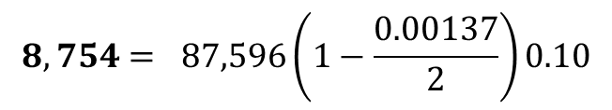

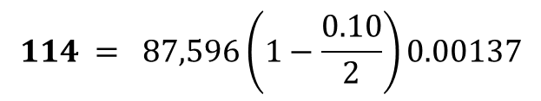



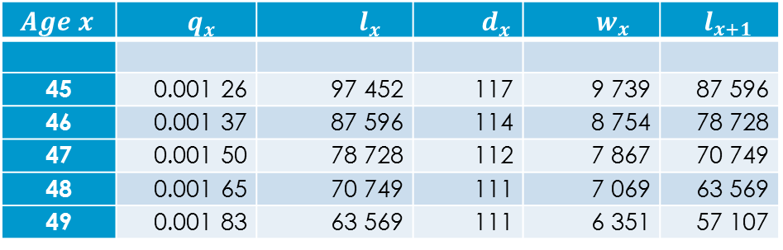
Multiple Decrement Tables
$${ Age x}_{ }$$ | $${ q}_{x}$$ | ${ l}_{x}$ | ${ d}_{x}$ | ${ w}_{x}$ | $${ l}_{x+1}$$
45 | 0.001 26 | 97 452 | 117 | 9 739 | 87 596
46 | 0.001 37 | 87 596 | 114 | 8 754 | 78 728
47 | 0.001 50 | 78 728 | 112 | 7 867 | 70 749
48 | 0.001 65 | 70 749 | 111 | 7 069 | 63 569
49 | 0.001 83 | 63 569 | 111 | 6 351 | 57 107
$$l_{x+1} = l_{x}\left(1−q_{x}\right)\left(1−ω_{x}\right)$$
$$d_{x} = l_{x}\left(1−\frac{ω_{x}}{2}\right)q_{x}$$
$$w_{x} = l_{x}\left(1−\frac{q_{x}}{2}\right)ω_{x}$$
$$114 = 87,596\left(1−\frac{0.10}{2}\right)0.00137$$
$$l_{x+1} = l_{x}− d_{x }−w_{x}$$
$$8,754= 87,596\left(1−\frac{0.00137}{2}\right)0.10$$
Values for non exact ages can be obtained by interpolation
$$78,728 = 87,596−114−8,754$$

Slide 22
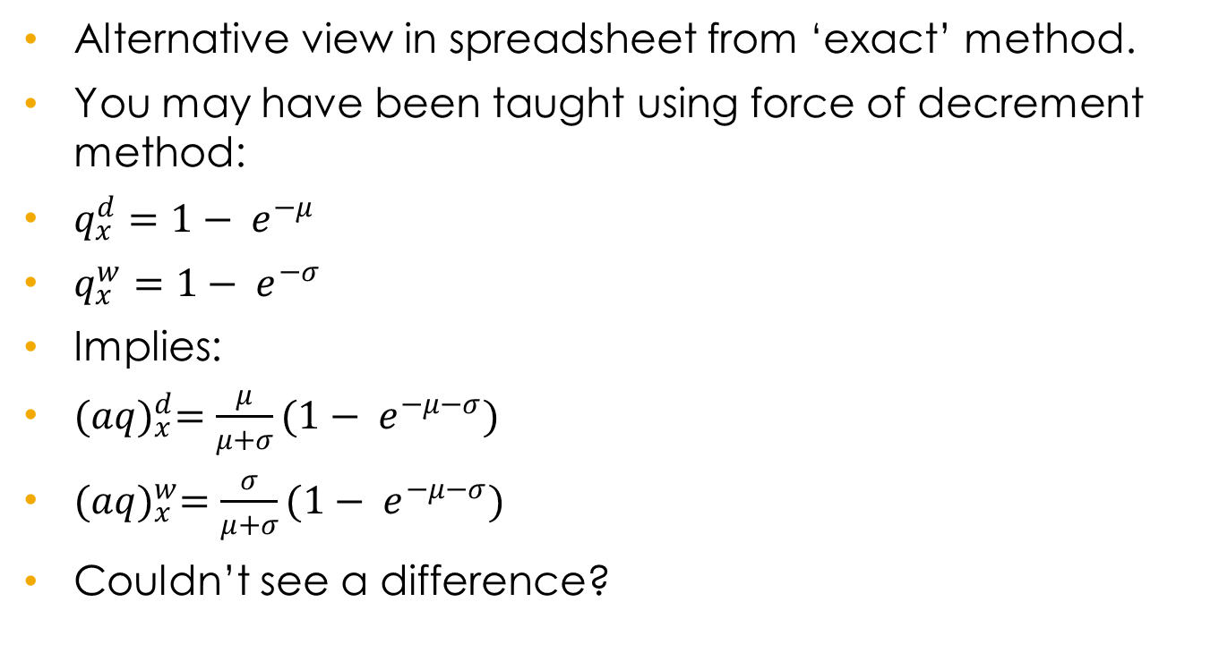
Multiple Decrement Tables – CT4 / CT5 core material
Alternative view in spreadsheet from ‘exact’ method.
You may have been taught using force of decrement method:
$q_{x}^{d}=1− e^{−μ}$
$q_{x}^{w}=1− e^{−σ}$
Implies:
${(aq)}_{x}^{d}=\frac{μ}{μ+σ}(1− e^{−μ−σ})$
${(aq)}_{x}^{w}=\frac{σ}{μ+σ}(1− e^{−μ−σ})$
Couldn’t see a difference?

Slide 23
Tutorial 2: Assignment
A few suggestions

Slide 24
Assignment
Writing skills – independent of mechanism (pen, keyboard, feather, …)
Read a book on writing
E.g. Professional Writing by Sky Marsen covers relevant topics such as report writing and critical thinking.
Take note of the rubric

Slide 25
Portion of the rubric
Weight: 30% | Significantly above pass level | Above pass level | Pass level | Some improvement required | Significantly below pass level
Assumption set | Clear explanation of all assumptions, why they are relevant and connections among assumptions are clearly described. Numerical values are sensible. | Logical explanation of all assumptions, why they are relevant and connections among assumptions are outlined. No irrelevant assumptions. Numerical values are sensible. | The assumptions are listed and contain sensible numerical values but there is a lack of clarity on why some are relevant or irrelevant assumptions are present. | A material component is missing from the assumptions. | Unclear explanation and material components missing.
Flowchart (Note that a picture of a hand drawn flowchart is acceptable.) | Well-designed, easy -to-read flowchart that accurately documents the steps to calculate the initial contribution rate for the PUC method. | Well-designed, easy -to-read flowchart that documents the steps although there is a lack of detail on some of the steps. | Well-designed, easy -to-read flowchart that documents the steps but has one or two flaws. | Flowchart has a good structure but is badly presented or does not use the standard design. | Hastily drawn flowchart with unclear logic.
Spreadsheet | Clearly coded with separation of data, assumptions, calculations and output as well as clear explanatory notes. Accurate calculations, formulas logically consistent and easy to read. Any macros or VBA used are identified with commentary | Separation of data, assumptions, calculations and output as well as reasonable explanatory notes. Accurate calculations, formulas logically consistent but not always clear. Any macros or VBA used are identified with commentary | Separation of data, assumptions, calculations and output as well as brief explanatory notes. Formulas logically consistent and appears to be accurate calculations although some difficulties in following the calculations . Any macros or VBA used are identified with commentary | Separation of data, assumptions, calculations and output but unclear explanatory notes. Difficult to follow the formula construction or the description is unclear. Any macros or VBA used are identified. It looks like some inaccuracies in the valuation method. | Poor design of spreadsheet or inconsistent formulae or inaccurate formulae. Unclear if any macros or VBA used. Poor explanation in the spreadsheet.

Slide 26
Preparation for Tutorial 3
Up to you – active not passive

Slide 27
Week 3 suggested work
Read Modules 4 and 8 (excluding section 8.5): Liabilities and assumptions
Rewrite Module summaries in your own words
Practice your writing skills by summarising section 5.2
Send any questions/requests for topics via the general discussion thread . Closing date will be end of Monday. No burning issues form last week?
Look at e.g. AMP’s accounts

